Slide 1

Exploratory Data Analysis Forestfire Dataset
MTech – 2020 - Batch B – Team- 6
Pranita Keshri
Satish
Sunil
Vijay Kashyap

Slide 2
EDA of Forest Fires
Problem statement : Impact of temperature, season, fire Index Parameters on forest fires
Analysis methods:
Data clean up Activity:
Identify rows and columns which are not used in analysis and drop them.
Data Analysis :
Effect of temp on total burnt area
Month wise total burnt area, mean temperature and burnt area
Effect of fuel parameters on total burnt area
Methods used to explore the data:
Pandas: analyze, sort, group, filter and drop the data
Seaborn: relpot,scatterplot
Plotly: Histogram
Matplotlib: donut graph

Slide 3
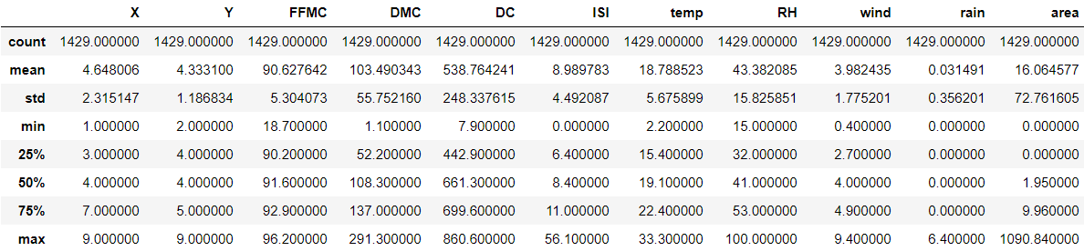
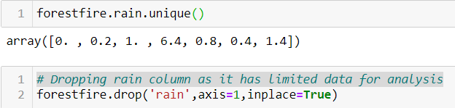
Data Cleansing Steps
Column Cleansing: Rain doesn’t have effect on forest fires. Hence dropping the column
Row Cleansing: Removing rows where area burnt is Zero

Slide 4
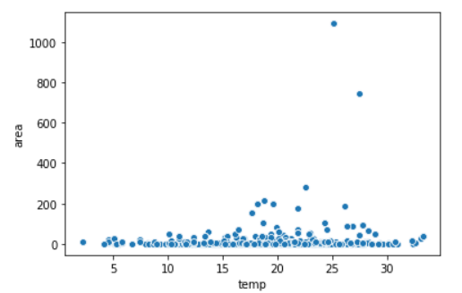

Temperature vs Area Burnt

Slide 5
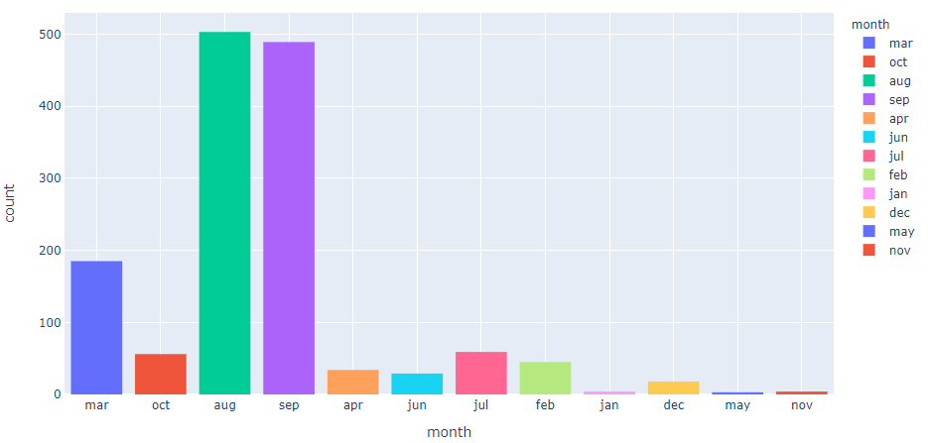

Month in which more fires are observed?

Slide 6
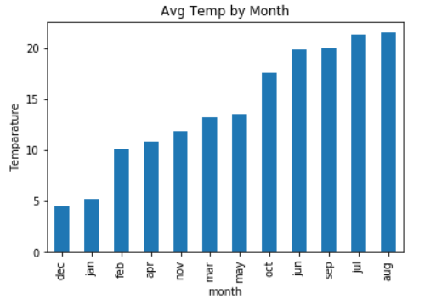
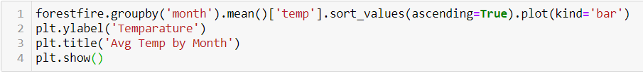
Average temperature by Month

Slide 7
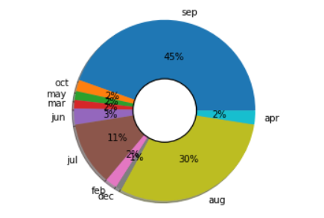
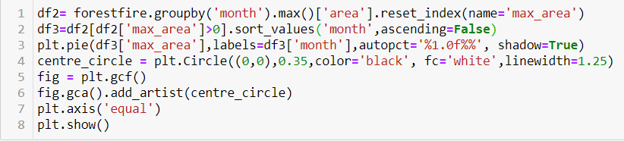
Month in which maximum area is burnt

Slide 8
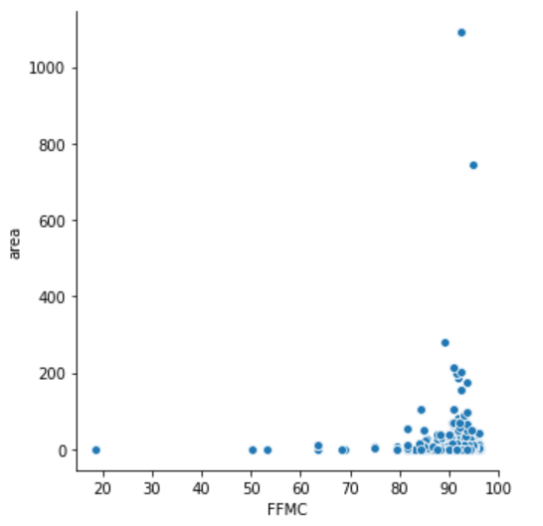
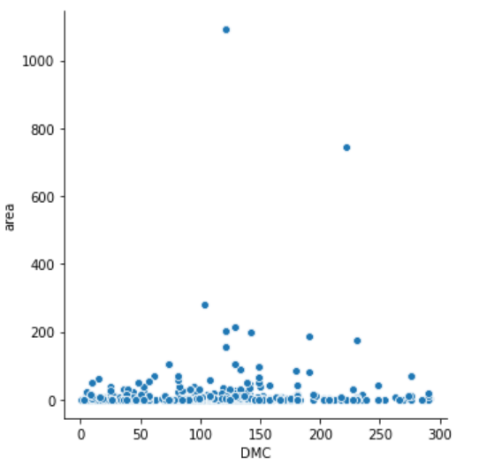
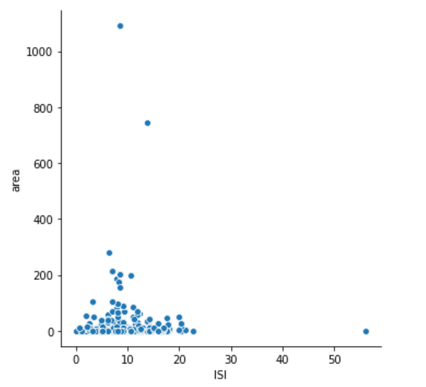
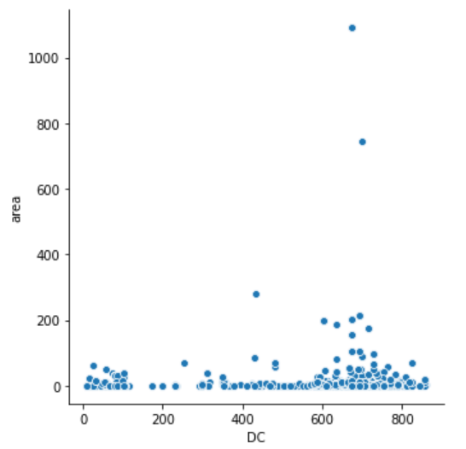
Effects of fuel parameters on burnt area

Slide 9
Thank You

